Slide 1
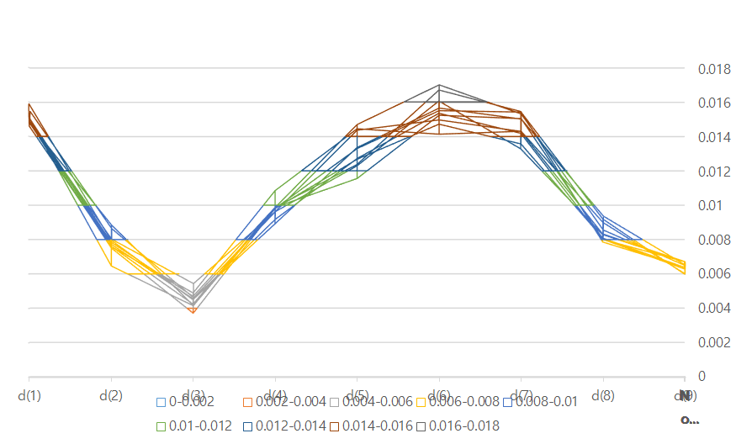
Breast Cancer - FLD weight
value
fold
dimension

Slide 2
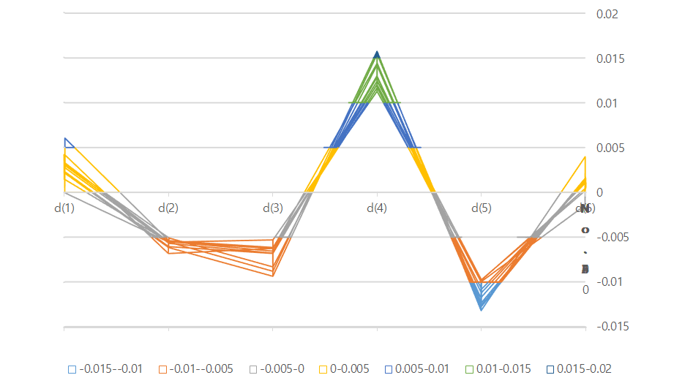
Bupa Liver Disorder- FLD weight
value
fold
dimension

Slide 3
Credit Approval - FLD weight
value
fold
dimension

Slide 4
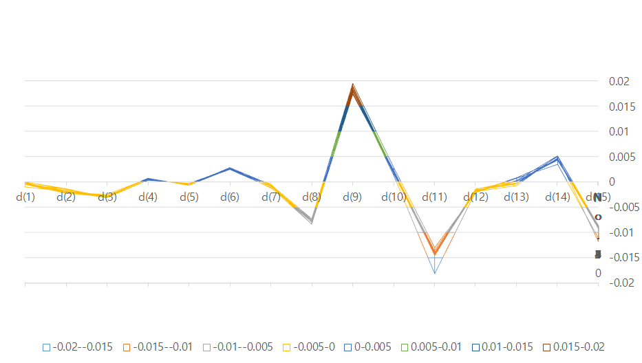
Credit Approval - FLD weight(2D)

Slide 5
Ionsphere - FLD weight
value
fold
dimension

Slide 6
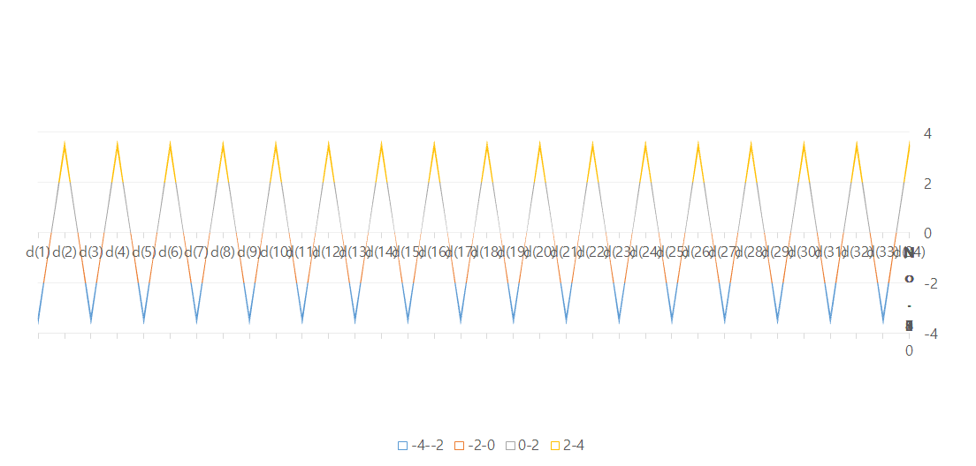
Ionsphere - FLD weight(2D)

Slide 7
J(w) of UCI dataset
<J(w) of UCI dataset>
fold | bc | bp | ca | io
1 | 0.031591 | 0.000068 | 0.011577 | 0.000697
2 | 0.030445 | 0.000376 | 0.011475 | 0.000739
3 | 0.029966 | 0.002313 | 0.01145 | 0.000796
4 | 0.031094 | 0.000914 | 0.011237 | 0.0007
5 | 0.028872 | 0.000141 | 0.011033 | 0.000677
6 | 0.030844 | 0.000053 | 0.011667 | 0.000786
7 | 0.030557 | 0.000047 | 0.011577 | 0.000743
8 | 0.029846 | 0.00002 | 0.011361 | 0.000666
9 | 0.033216 | 0.000493 | 0.011588 | 0.00084
10 | 0.031288 | 0.000392 | 0.011281 | 0.000672
ave | 0.030772 | 0.000482 | 0.011425 | 0.000732

Slide 8
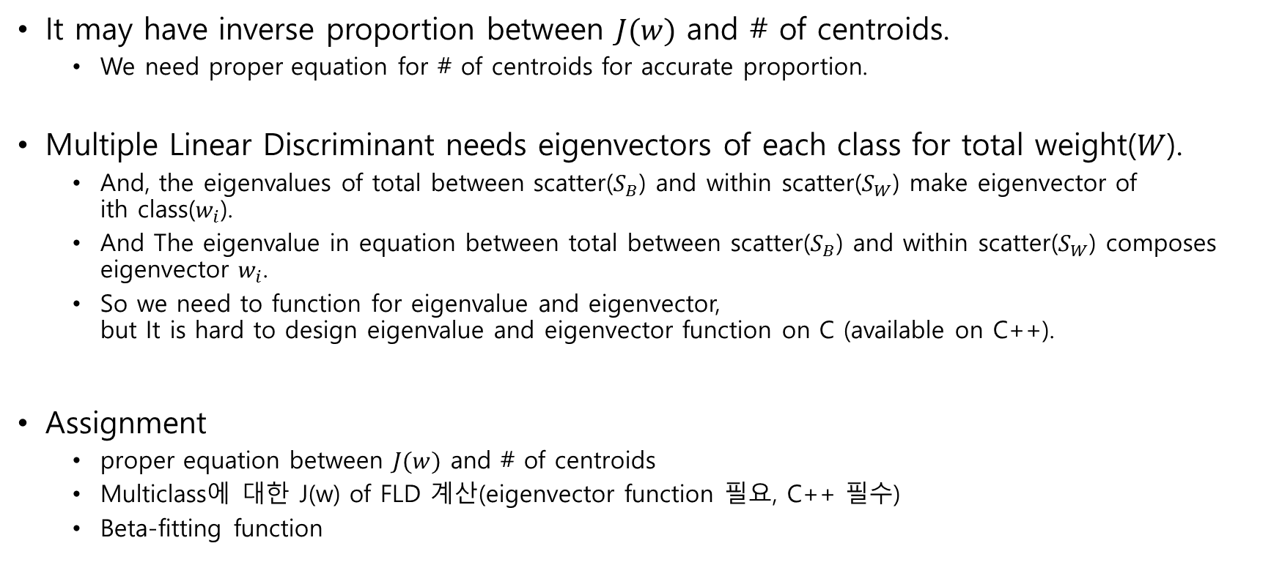
Conclusion
It may have inverse proportion between $J(w)$ and # of centroids.
We need proper equation for # of centroids for accurate proportion.
Multiple Linear Discriminant needs eigenvectors of each class for total weight($W$).
And, the eigenvalues of total between scatter($S_{B}$) and within scatter($S_{W}$) make eigenvector of ith class($w_{i}$).
And The eigenvalue in equation between total between scatter($S_{B}$) and within scatter($S_{W}$) composes eigenvector $w_{i}$.
So we need to function for eigenvalue and eigenvector, but It is hard to design eigenvalue and eigenvector function on C (available on C++).
Assignment
proper equation between $J(w)$ and # of centroids
Multiclass에 대한 J(w) of FLD 계산(eigenvector function 필요, C++ 필수)
Beta-fitting function

